Slide 1
MongoDB CRUD operations

Slide 2
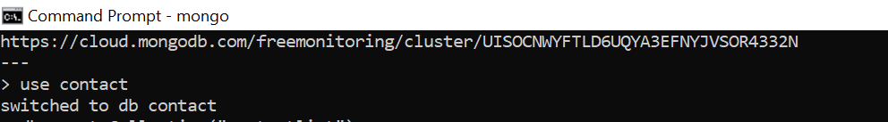

Create a collection called "contactlist"
Create a database called "contact"

Slide 3

Insert these documents in "contactlist" : Last name: Ben Lahmer, First name: Fares, Email: fares@gmail.com, age:26 Last name: Kefi, First name: Seif, Email: kefi@gmail.com, age:15 Last name: Fatnassi, First name: Sarra, Email: sarra.f@gmail.com, age:40 Last name: Ben Yahia, First name: Rym, age:4 Last name: Cherif, First name: Sami, age:3

Slide 4
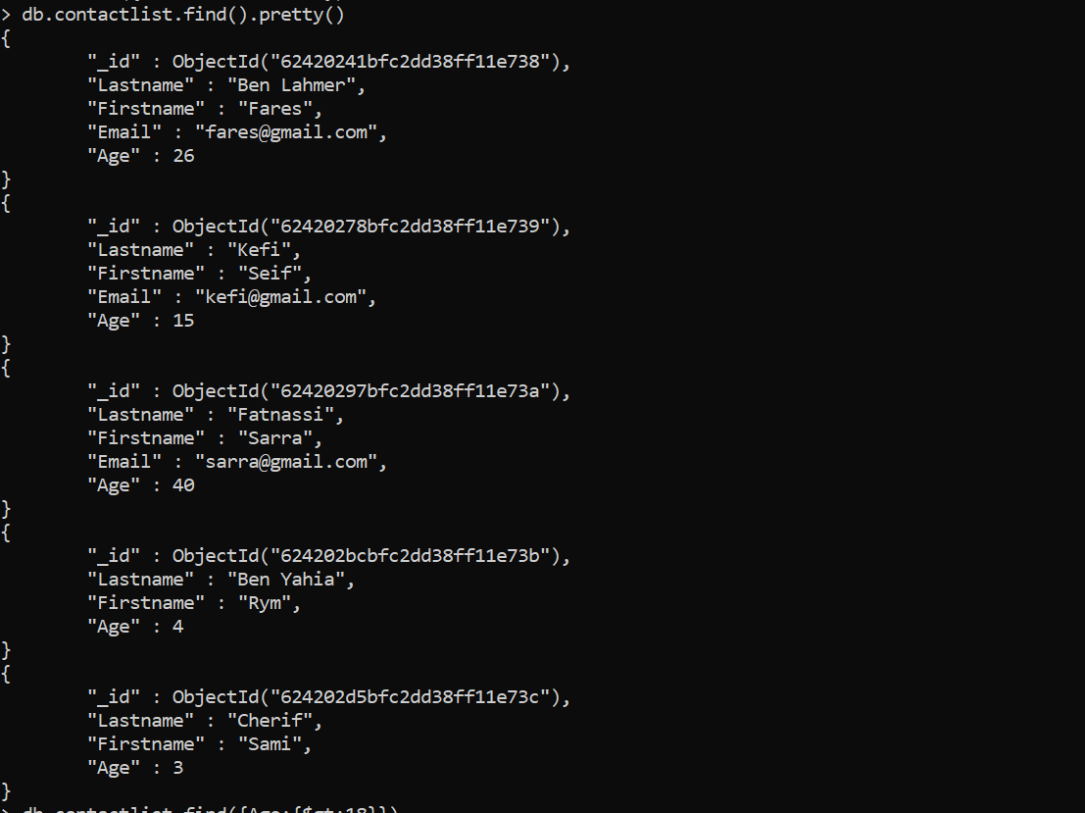
Display all the information about only one person using his ID

Slide 5
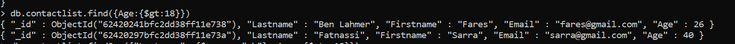
Display all the contacts with an age >18

Slide 6

Display all the contacts with an age>18 and name containing "ah"

Slide 7
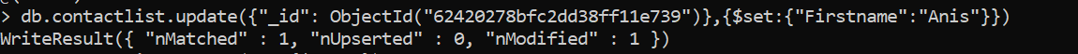
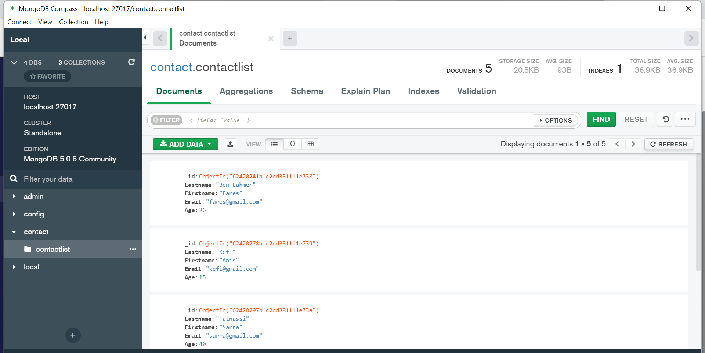
Change the contact's first name from"Kefi Seif" to "Kefi Anis"

Slide 8
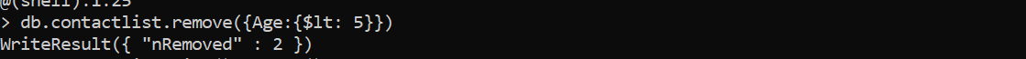
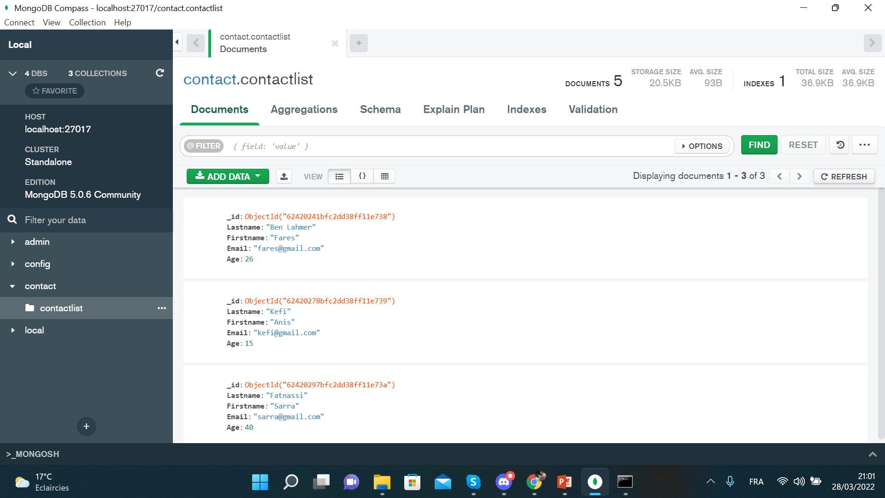
Delete the contacts that are aged under <5

Slide 9
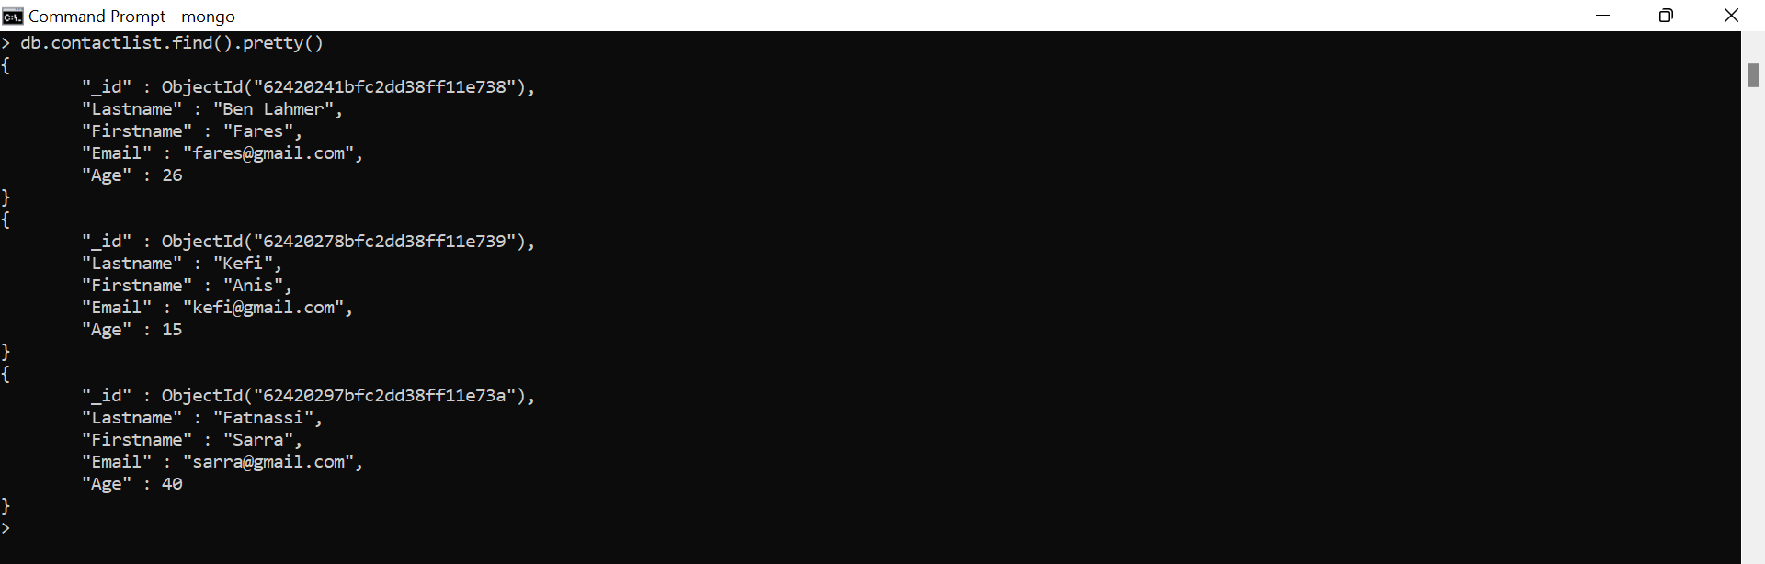
Display all of the contacts list

